Slide 1

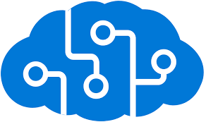


Overview of Azure AI Services and Their Integration with RAG Applications
By RDP Team

Slide 2
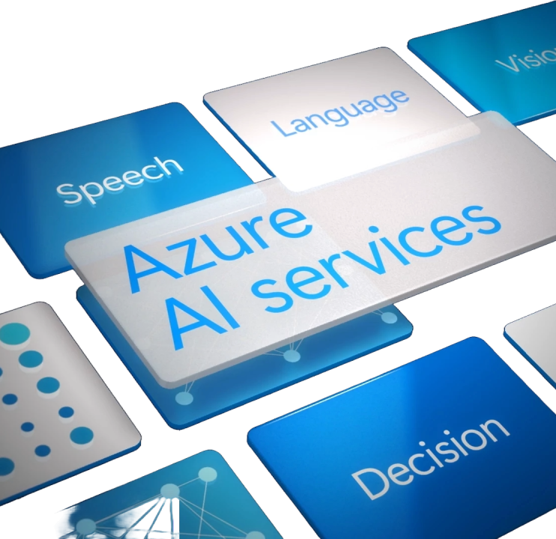
Agenda
Introduction to Azure AI Services
Using Azure Portal with various Azure AI Services
Code based demo for working with Azure AI Services
LLM/RAG introduction and benefits of integrating with Azure AI services

Slide 3
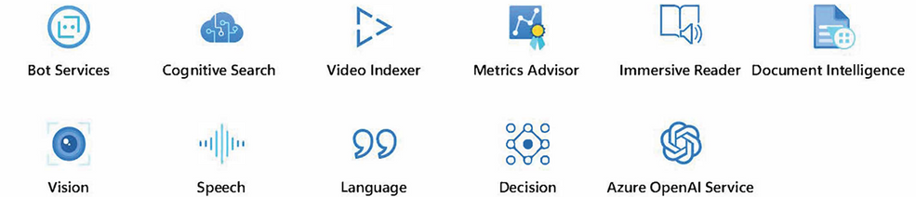
Introduction to Azure AI Services
Prebuilt AI models allow for fast development without the need to train your own models.
Easily integrate advanced capabilities like natural language processing, computer vision, and speech recognition.
Quickly deploy scalable and reliable AI-powered applications without custom model training.
Ensures high standards of security, compliance, and performance with minimal setup.

Slide 4
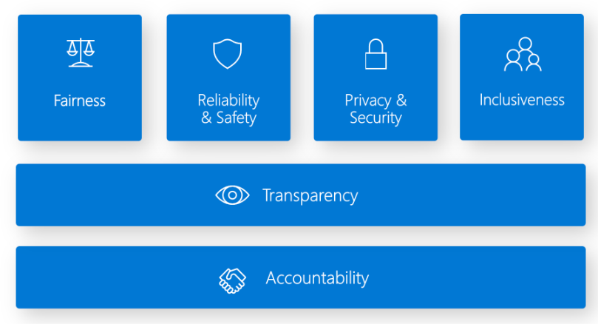
Responsible AI
Fairness: AI systems should treat all individuals equitably, avoiding bias or discrimination.
Reliability and Safety: AI systems must function consistently and safely across various scenarios.
Transparency: AI decisions should be clear and explainable to users and stakeholders.
Privacy and Security: AI systems must protect personal data and comply with privacy regulations.
Inclusiveness: AI systems should consider diverse users and ensure accessibility for all.
Accountability: Developers and organizations must be responsible for AI outcomes and maintain oversight throughout the system's lifecycle.

Slide 5
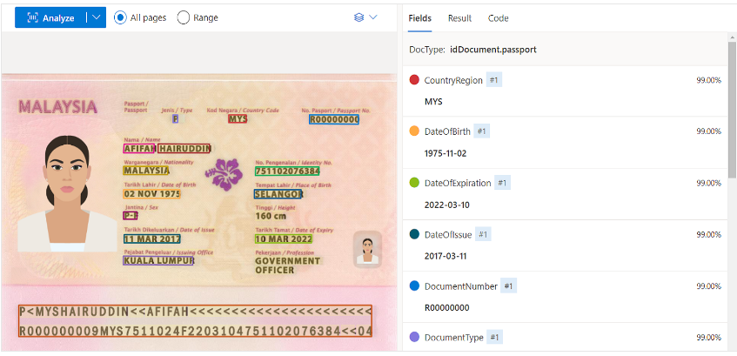
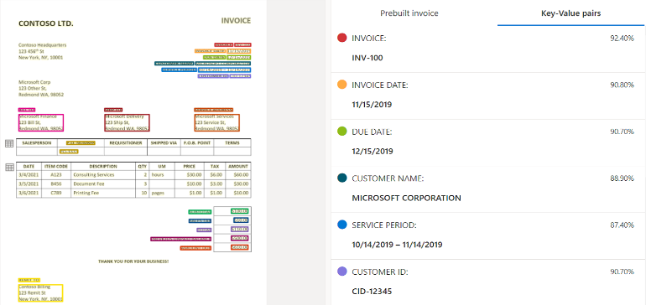
Computer Vision: OCR for Document Digitization
OCR extracts text from printed and handwritten documents, converting them into digital formats.
Supports multiple languages, making it ideal for global document digitization.
Useful for digitizing invoices, receipts, and business cards, improving document management.
Uses deep learning models to ensure high accuracy and scalability for large projects.

Slide 6
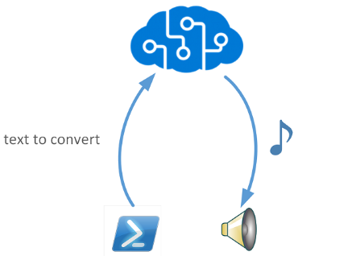
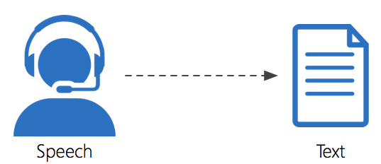
Speech Services: Speech-to-Text and Text-to-Speech
Speech-to-Text:
Converts spoken language to text using advanced recognition technology. Supports multiple languages and accents, ideal for transcription and voice commands.
Text-to-Speech:
Turns text into natural-sounding speech with prebuilt and custom neural voices. Uses deep neural networks for high-quality synthesis and supports SSML for customization.

Slide 7

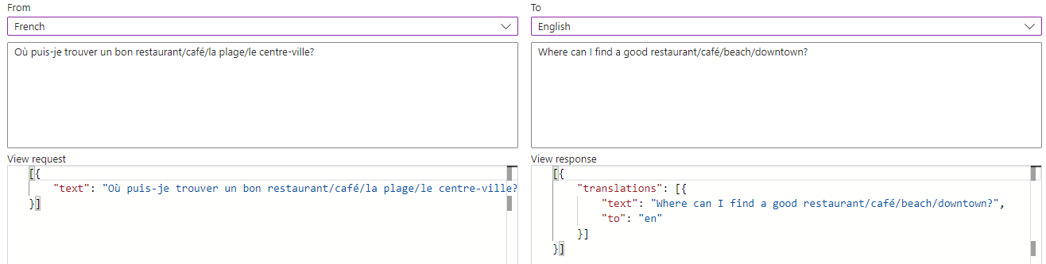
AI Translator
Azure Translator provides real-time translation across multiple languages, making it ideal for global communication and multilingual applications.
Easily integrates into apps, websites, and services to offer seamless language translation with high accuracy.

Slide 8
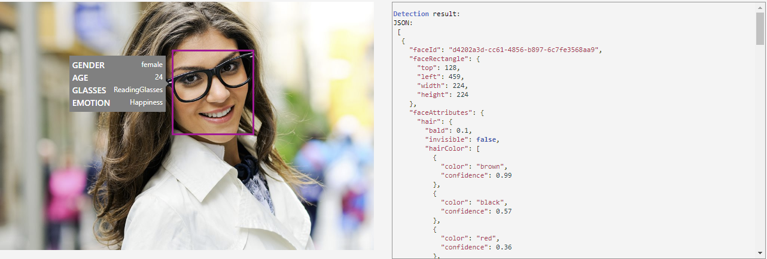
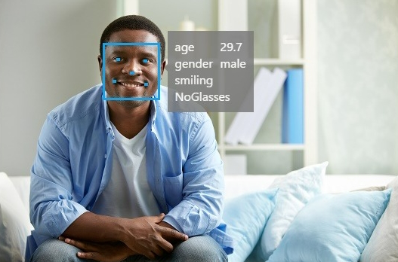
Face API
Azure Face API detects and analyzes human faces in images, providing features like face recognition, emotion detection, and facial attribute extraction.
It enables applications to perform tasks such as identity verification, emotion analysis, and facial authentication with high accuracy.

Slide 9
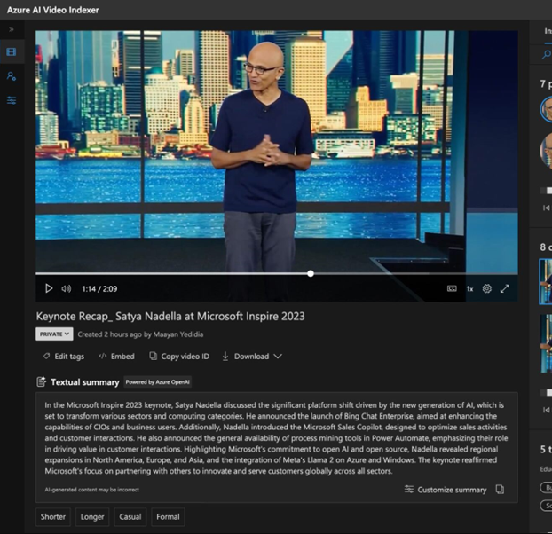
Video Indexer
Transcribes speech and translates it into multiple languages with subtitles.
Detects objects, faces, and emotions within video content.
Extracts metadata like keywords, scene segmentation, and sentiment analysis.
Performs OCR to recognize and extract text appearing in videos.

Slide 10

Video Indexer
By enabling AI features with an Azure OpenAI resource, you unlock additional capabilities such as:
Automated Video Summarization: Generate concise summaries of video content.
Enhanced Accuracy: Benefit from more coherent and human-like summarization and metadata extraction.
Customization: Tailor the tone and length of video summaries to your needs.
Broader Use Cases: Suitable for education, media, and corporate applications.

Slide 11
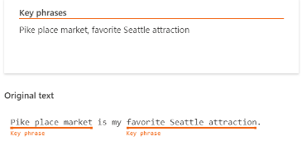
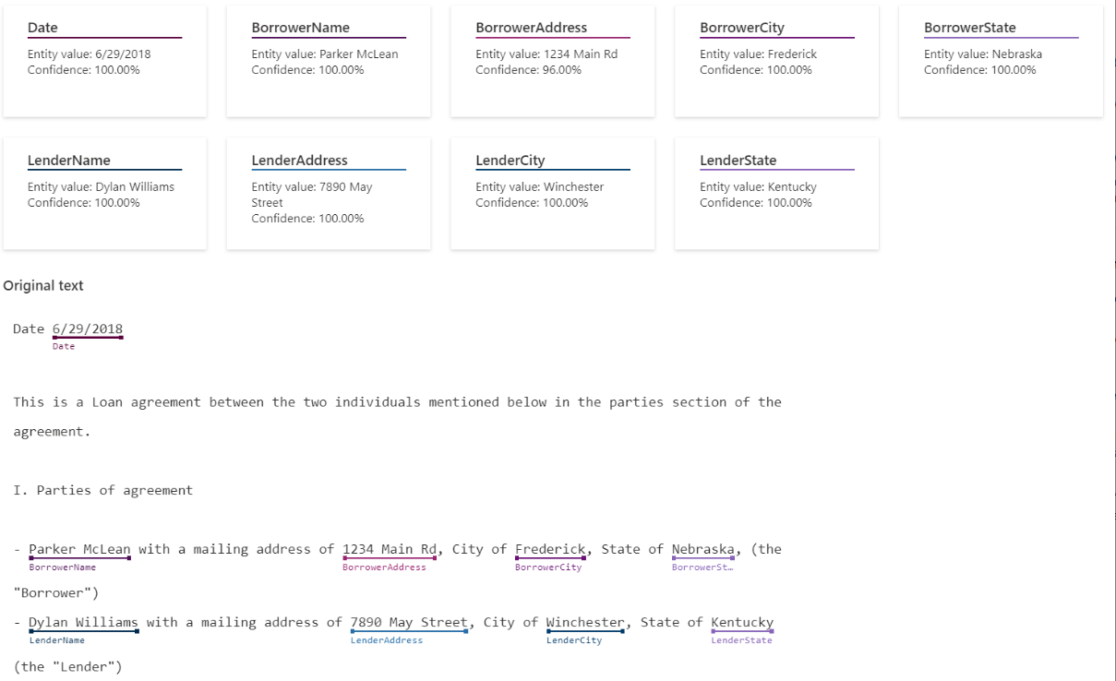
Text Analytics: Key Phrase Extraction and Entity Recognition
Key Phrase Extraction:
Automatically identifies and extracts the main concepts and phrases from unstructured text, helping to summarize and categorize content efficiently.
Named Entity Recognition (NER):
Detects and categorizes entities such as people, places, and dates within text, aiding in the organization and understanding of large volumes of information.

Slide 12

Text Analytics API – Python Code Based Demo

Slide 13
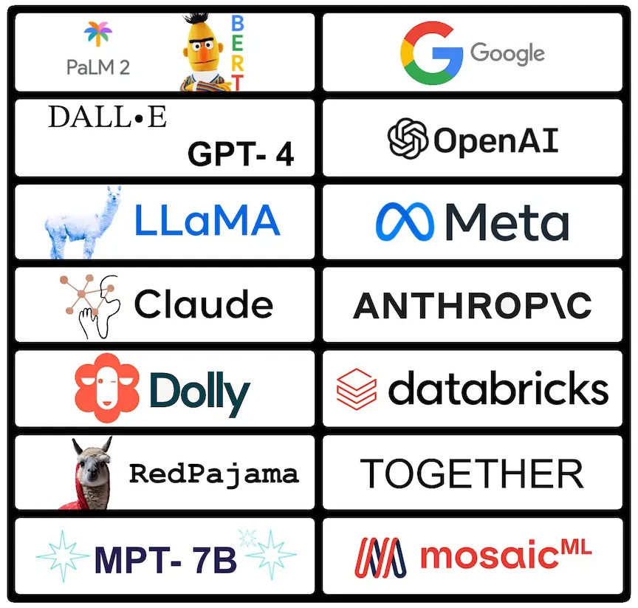
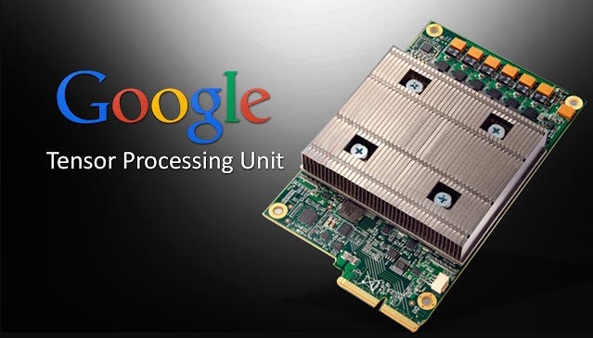
Foundation Models
It is highly impractical, if not impossible to train your own LLM due to AI expertise needed and the amount of computing power needed.
It is more practical to use pre-trained models, called Foundation Models from the big tech companies

Slide 14
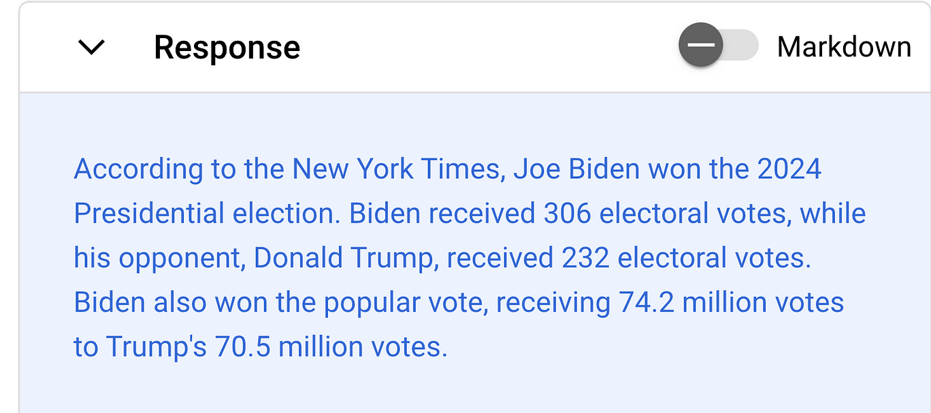
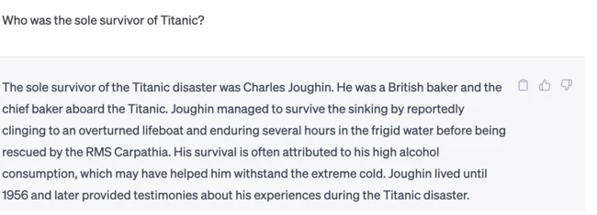
LLM Problems - Hallucinations
LLMs often generate confident answers on topics they weren’t trained on, leading to incorrect information (hallucinations).
RAG helps reduce hallucinations by providing additional, real-time context to ground the LLM's responses.

Slide 15
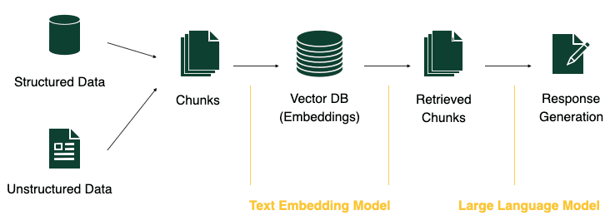
RAG (retrieval-augmented generation)
Convert Text to Numbers: The input text is turned into a list of numbers (a vector) that represents its meaning.
Find Similar Text: This vector is compared to other vectors in a database using cosine similarity to find similar texts.
Retrieve Similar Text: The most similar text from the database is retrieved.
Use in LLM: The retrieved text is added to the large language model's context, improving the accuracy of its response.

Slide 16
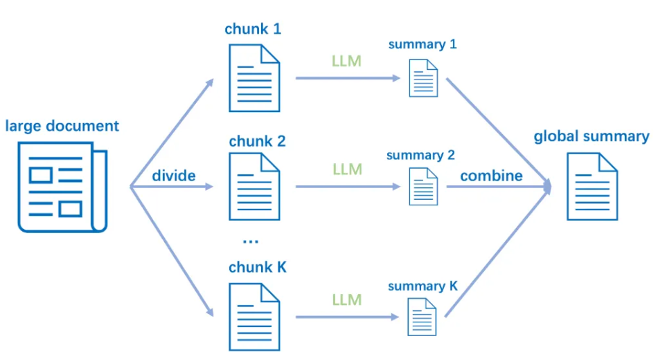
Chunking
Chunking breaks long texts into manageable sections
A common strategy is to split text by a number of words or sentences
Chunking strategies are actively being researched
Input Text:
"Data is becoming a critical asset for businesses. Companies need efficient ways to manage and analyze it. Cloud platforms provide scalable solutions for handling large datasets. Azure offers various services for data storage, processing, and analysis. Machine learning models can extract valuable insights from this data. These insights help drive better decision-making across industries.“
Chunk 1: "Data is becoming a critical asset for businesses. Companies need efficient ways to manage and analyze it.“
Chunk 2: "Cloud platforms provide scalable solutions for handling large datasets. Azure offers various services for data storage, processing, and analysis.“
Chunk 3: "Machine learning models can extract valuable insights from this data. These insights help drive better decision-making across industries."

Slide 17
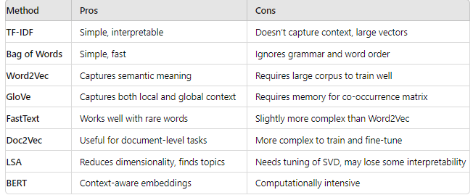
Vector Representation
You can turn text into numbers (called vectors) using different methods. In LLMs (Large Language Models), an embedding model converts the text into a vector.
Example:
Text: “I love cake”
Vector: [0.01, 0.02, 0.062, …]
Text: “Cats are cute”
Vector: [0.05, 0.08, 0.09, …]
Text: “Let's go hiking”
[0.03, 0.07, 0.11, …]

Slide 18
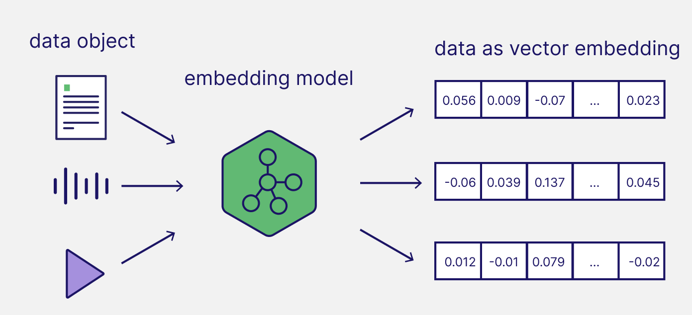
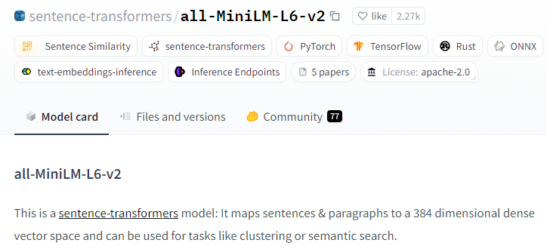
Embedding Model
Preferred Approach for LLMs: Embedding models are a common method to convert text into vectors for LLMs.
Open Source Availability: You can find open-source embedding models on platforms like Hugging Face.
Versatile Use Cases: Embedding models are crucial for tasks like semantic search, clustering, and similarity analysis by transforming text into dense vector spaces.

Slide 19
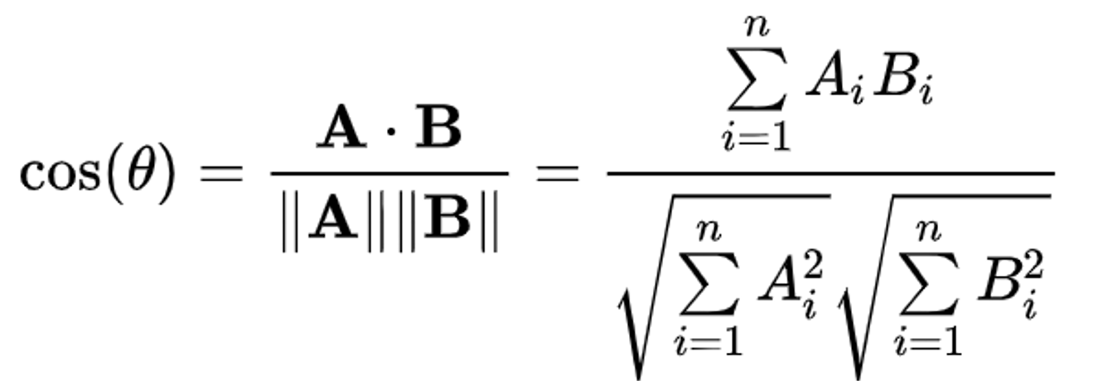
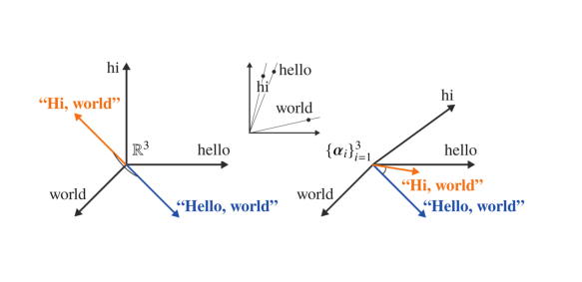
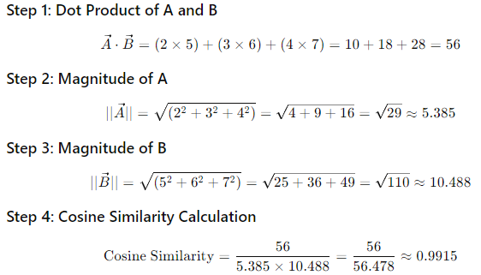
Cosine Similarity
Vector A = [2,3,4] Vector B = [5,6,7]
Cosine Similarity shows how similar two sentences are in meaning by turning them into numbers (vectors).
Example:
"I like cats" and "I like dogs" would have a high similarity because they mean almost the same thing.
"Johnny Bravo" would have low similarity with both because it's unrelated.
The score goes from 0 (completely different) to 1 (exactly the same).

Slide 20
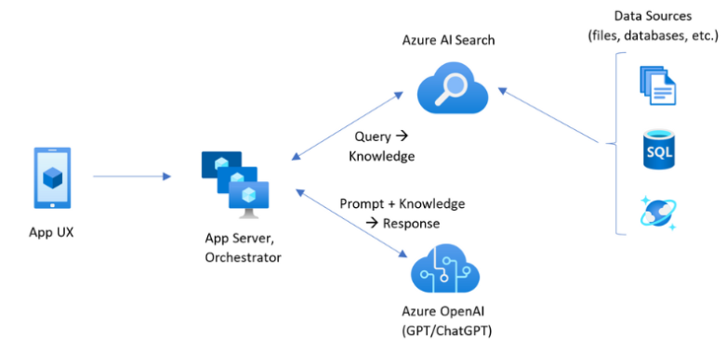
Integration with RAG Applications
Benefits:
State of the Art Models: Microsoft’s partnership with OpenAI ensures access to cutting-edge models.
All-in-One Platform: Azure provides LLMs via Azure OpenAI, vector databases with Azure AI Search, and storage with Azure Blob.
Seamless Integration: Use other Azure AI services like Document Intelligence to extract and feed data into your vector databases.
Scalable & Secure: Easily scale RAG systems with integrated, enterprise-ready AI services.
Production Ready: Gain other benefits from the Azure ecosystem such as access control, networking, security, and data encryption.

Slide 21

Azure AI Search
Azure AI Search is a vector store for semantic search.
Supports full-text search and vector embeddings.
Enables k-nearest neighbor (KNN) similarity search.
Integrates with AI-powered features like OCR and entity recognition.

Slide 22
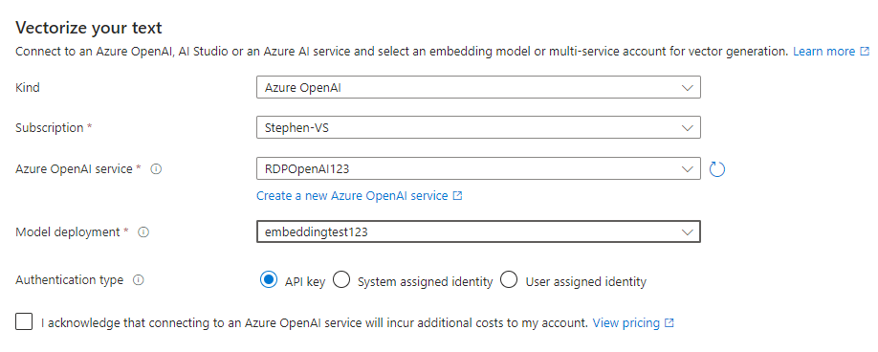
Azure AI Search
Built-in Embedding: Azure AI Search offers a built-in embedding model for vectorizing your data.
Time-saving: Eliminates the need for managing your own embedding models, reducing overhead.
Seamless Integration: Easily connect to Azure services like Blob Storage, Data Lake, and OneLake for data import and processing.

Slide 23
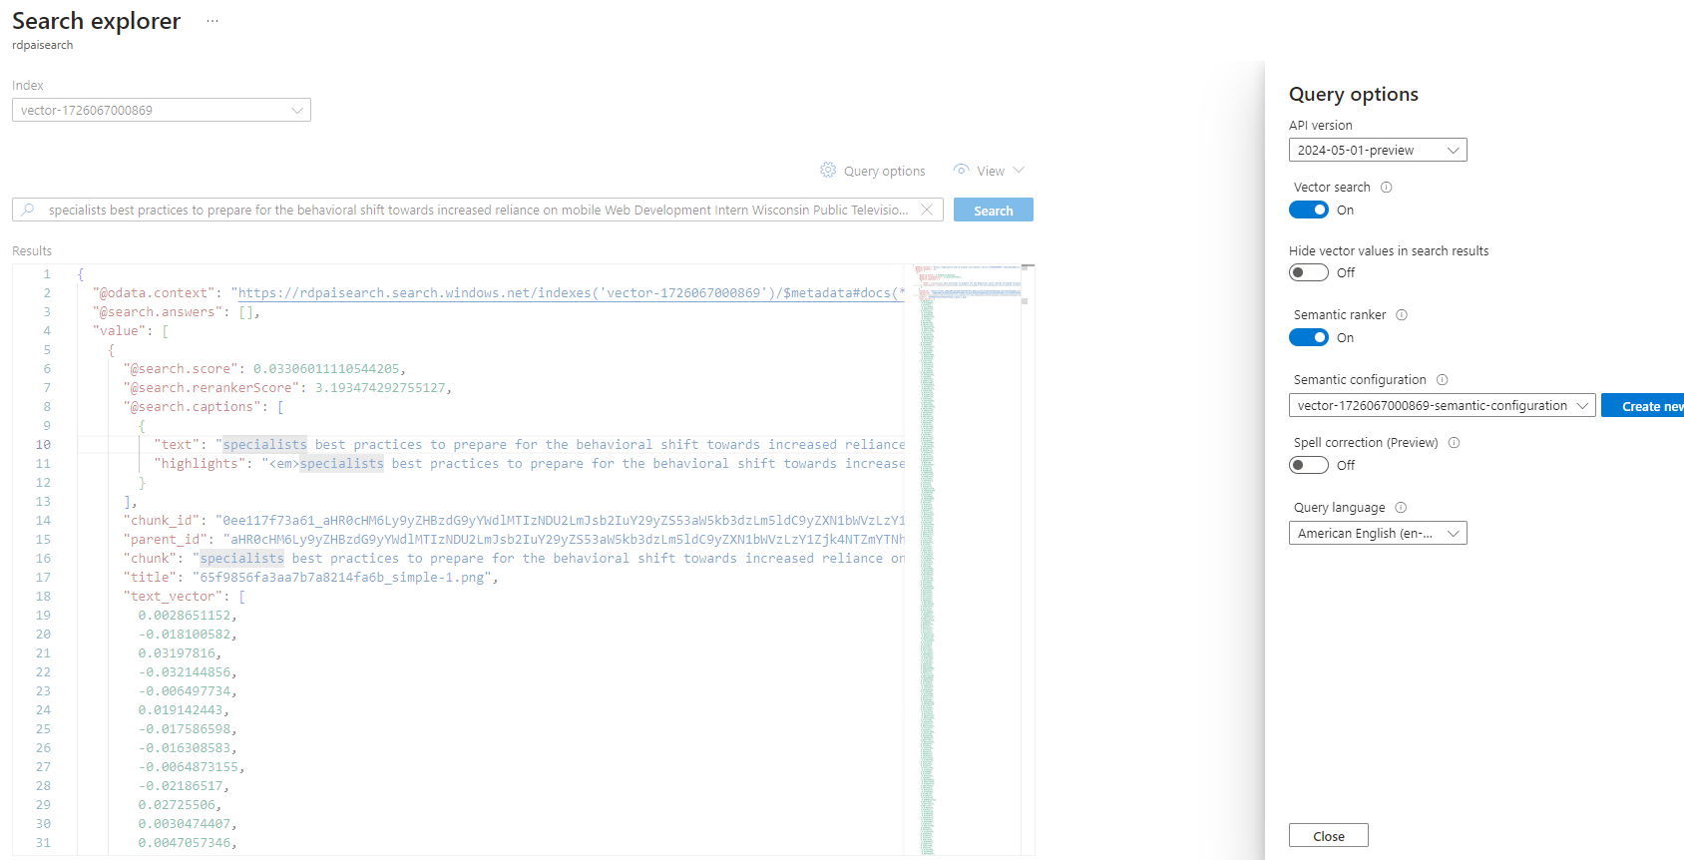

Slide 24
Azure AI Search
You can integrate AI Search with AI Services using AI Search using Skillsets
This lets you leverage the AI services directly before loading your data into AI Search
Example: There are documents that contained unstructured data and you need to load the data into Azure AI Search for your LLM/AI application. Instead of writing the code for the data extraction, leverage Azure AI Search Skillsets to automatically extract the relevant data and load it into the data store.

Slide 25
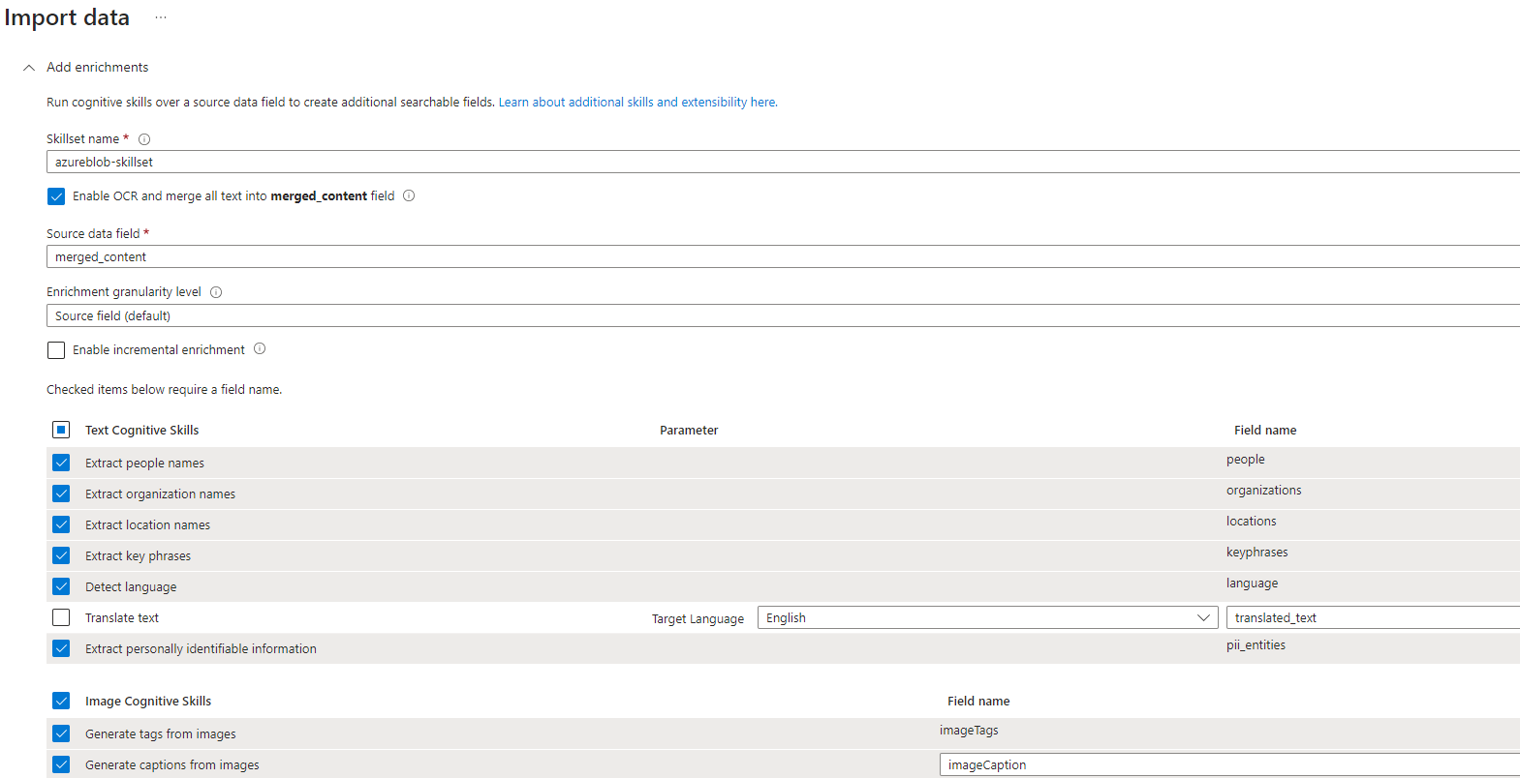

Slide 26
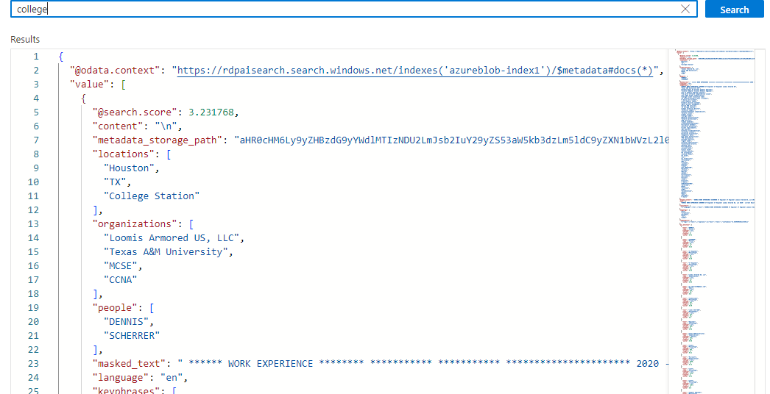

Slide 27

Thank You

